Slide 2
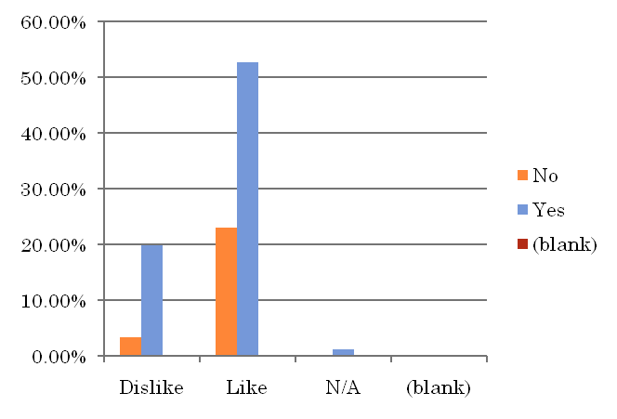
ANS 5
% of Total | sex
like/dislike | Female | Male | (blank) | Grand Total
Dislike | 12.09% | 10.99% | 0.00% | 23.08%
Like | 28.57% | 47.25% | 0.00% | 75.82%
N/A | 0.00% | 1.10% | 0.00% | 1.10%
(blank) | 0.00% | 0.00% | 0.00% | 0.00%
Grand Total | 40.66% | 59.34% | 0.00% | 100.00%
% of Total | own
like | No | Yes | (blank) | Grand Total
Dislike | 3.30% | 19.78% | 0.00% | 23.08%
Like | 23.08% | 52.75% | 0.00% | 75.82%
N/A | 0.00% | 1.10% | 0.00% | 1.10%
(blank) | 0.00% | 0.00% | 0.00% | 0.00%
Grand Total | 26.37% | 73.63% | 0.00% | 100.00%

Slide 3
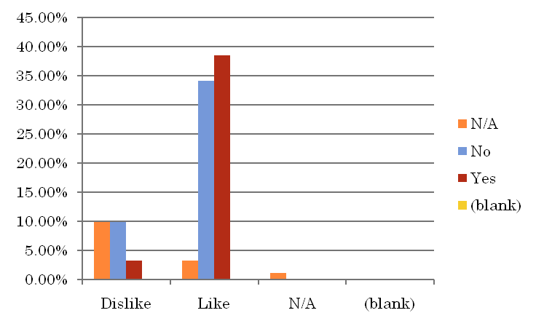
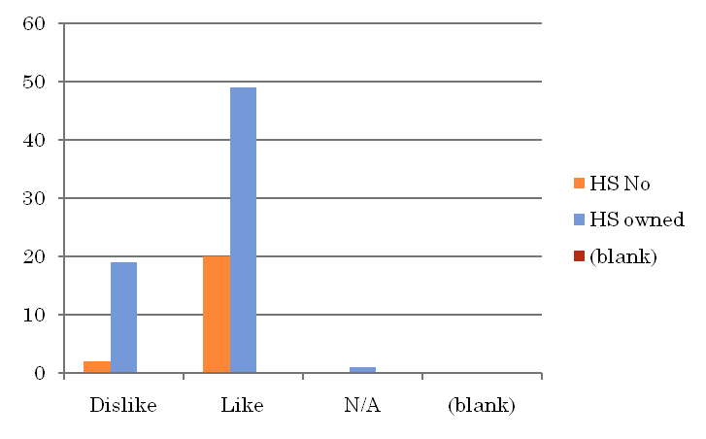
ANS 5
% of Total | educ
like | N/A | No | Yes | (blank) | Grand Total
Dislike | 9.89% | 9.89% | 3.30% | 0.00% | 23.08%
Like | 3.30% | 34.07% | 38.46% | 0.00% | 75.82%
N/A | 1.10% | 0.00% | 0.00% | 0.00% | 1.10%
(blank) | 0.00% | 0.00% | 0.00% | 0.00% | 0.00%
Grand Total | 14.29% | 43.96% | 41.76% | 0.00% | 100.00%
% of Total | home
like | HS No | HS owned | (blank) | Grand Total
Dislike | 2 | 19 |  | 21
Like | 20 | 49 |  | 69
N/A |  | 1 |  | 1
(blank)
Grand Total | 22 | 69 |  | 91

Slide 4
ANS 5
% of Total | educ
like | N/A | No | Yes | (blank) | Grand Total
Dislike | 9.89% | 9.89% | 3.30% | 0.00% | 23.08%
Like | 3.30% | 34.07% | 38.46% | 0.00% | 75.82%
N/A | 1.10% | 0.00% | 0.00% | 0.00% | 1.10%
(blank) | 0.00% | 0.00% | 0.00% | 0.00% | 0.00%
Grand Total | 14.29% | 43.96% | 41.76% | 0.00% | 100.00%
% of Total | home
like | HS No | HS owned | (blank) | Grand Total
Dislike | 2 | 19 |  | 21
Like | 20 | 49 |  | 69
N/A |  | 1 |  | 1
(blank)
Grand Total | 22 | 69 |  | 91

Slide 5
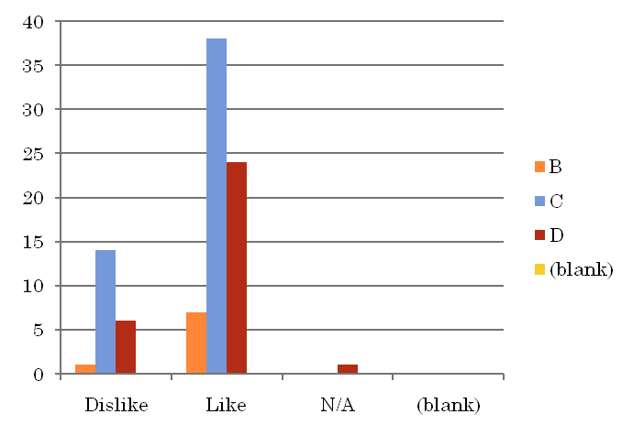
ANS 5
% of Total | math
like | Don't Hate | Hate It | N/A | (blank) | Grand Total
Dislike | 12.09% | 10.99% | 0.00% | 0.00% | 23.08%
Like | 54.95% | 19.78% | 1.10% | 0.00% | 75.82%
N/A | 0.00% | 1.10% | 0.00% | 0.00% | 1.10%
(blank) | 0.00% | 0.00% | 0.00% | 0.00% | 0.00%
Grand Total | 67.03% | 31.87% | 1.10% | 0.00% | 100.00%
Count | grade
like | B | C | D | (blank) | Grand Total
Dislike | 1 | 14 | 6 |  | 21
Like | 7 | 38 | 24 |  | 69
N/A |  |  | 1 |  | 1
(blank)
Grand Total | 8 | 52 | 31 |  | 91

Slide 6
ANS 2
Monotonic regression is used to estimate the average time a user spent given the frequency of his usage and the actual hrs
Overall average:
Average time spent(hrs) weekly 0.246689115
For the sample the average times for the people who have filled that they do not play when busy vs those who have filled that they will play when busy are given as:
  No-0.709311
  Yes-0.219993

